Slide 1
Cloud Computing
SEWP ZG527

Slide 2
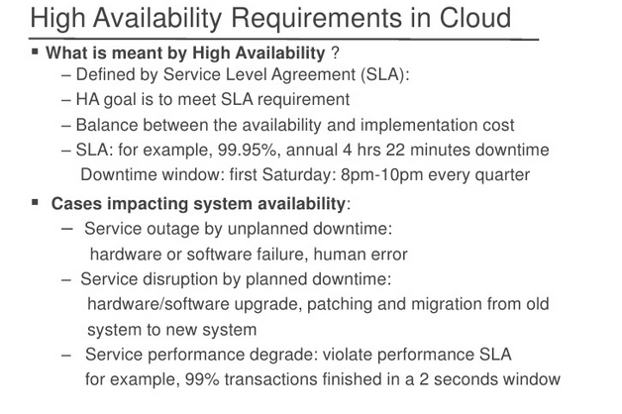
High Availability
Notes:
RL 7.1

Slide 3
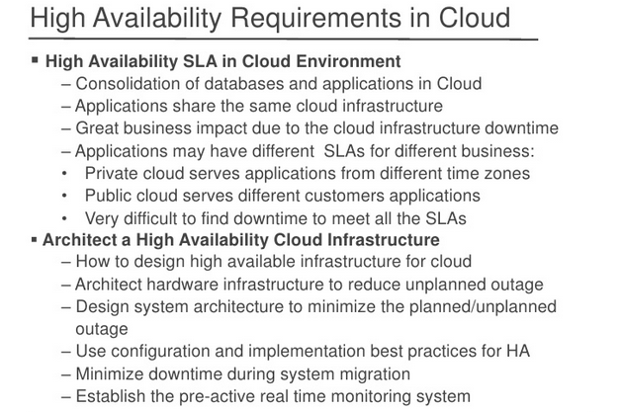
High Availability

Slide 4
High Availability
Steps to achieve high availabilty
Build for server failure
Build for zone failure
Build for Cloud failure
Automating and testing
Notes:
http://www.rightscale.com/blog/enterprise-cloud-strategies/four-steps-achieving-high-availability-cloud

Slide 5
Key aspects of SLA
In the early days of web-application deployment, performance of the application at peak load was a single important criterion for provisioning server resources.
Provisioning in those days involved deciding hardware conﬁguration, determining the number of physical machines, and acquiring them upfront so that the overall business objectives could be achieved.
The web applications were hosted on these dedicated individual servers within enterprises’ own server rooms. These web applications were used to provide different kinds of e-services to various clients.

Slide 6
Key aspects of SLA
Typically, the service-level objectives (SLOs) for these applications were response time and throughput of the application end-user requests.
The capacity buildup was to cater to the estimated peak load experienced by the application. The activity of determining the number of servers and their capacity that could satisfactorily serve the application end-user requests at peak loads is called capacity planning

Slide 7
Key aspects of SLA
Due to the increasing complexity of managing the hugh Data centres, enterprises started outsourcing the application hosting to the infrastructure providers. They would procure the hardware and make it available for application hosting.
It necessitated the enterprises to enter into a legal agreement with the infrastructure service providers to guarantee a minimum quality of service (QoS).
Typically, the QoS parameters are related to the availability of the system CPU, data storage, and network for efﬁcient execution of the application at peak loads.
This legal agreement is known as the service-level agreement (SLA)

Slide 8
Key aspects of SLA
For example, one SLA may state that the application’s server machine will be available for 99.9% of the key business hours of the application’s end users, also called core time, and 85% of the non-core time.
Another SLA may state that the service provider would respond to a reported issue in less than 10 minutes during the core time, but would respond in one hour during non-core time.
These SLAs are known as the infrastructure SLAs, and the infrastructure service providers are known as Application Service Providers (ASPs)

Slide 9
Key aspects of SLA
The dedicated hosting practice resulted in massive redundancies within the ASP’s data centers due to the underutilization of many of their servers. This is because the applications were not fully utilizing their servers’ capacity at nonpeak loads.
To reduce the redundancies and increase the server utilization in data centers, ASPs started co-hosting applications with complementary workload patterns.
Co-hosting of applications means deploying more than one application on a single server. This led to further cost advantage for both the ASPs and enterprises.

Slide 10
Key aspects of SLA
However, newer challenges such as application performance isolation and security guarantees emerged and needed to be addressed. Performance isolation implies that one application should not steal the resources being utilized by other co-located applications.
Hence, appropriate measures are needed to guarantee security and performance isolation. These challenges prevented ASPs from fully realizing the beneﬁts of co-hosting.
Virtualization technologies have been proposed to overcome the above challenges. The ASPs could exploit the containerization features of virtualization technologies to provide performance isolation and guarantee data security to different co-hosted applications

Slide 11
Key aspects of SLA
Adoption of virtualization technologies required ASPs to get more detailed insight into the application runtime characteristics with high accuracy. Based on these characteristics, ASPs can allocate system resources more efﬁciently to these applications on-demand, so that application-level metrics can be monitored and met effectively.
These metrics are request rates and response times. Therefore, different SLAs than the infrastructure SLAs are required. These SLAs are called application SLAs. These service providers are known as Managed Service Providers (MSP) because the service providers were responsible for managing the application availability too.

Slide 12
Key aspects of SLA
To fulﬁll the SLOs mentioned in the application SLA and also make their IT infrastructure elastic, an in-depth understanding of the application’s behavior is required for the MSPs. Elasticity implies progressively scaling up the IT infrastructure to take the increasing load of an application. The customer is billed based on their application usage of infrastructure resources for a given period only. The infrastructure can be augmented by procuring resources dynamically from multiple sources, including other MSPs, if resources are scarce at their data centers. This kind of new hosting infrastructure is called cloud platform.

Slide 13
Key aspects of SLA
Traditionally, load balancing techniques and admission control mechanisms have been used to provide guaranteed quality of service (QoS) for hosted web applications. These mechanisms can be viewed as the ﬁrst attempt towards managing the SLOs.
Now it is also possible for a customer and the service provider to mutually agree upon a set of SLAs with different performance and cost structure rather than a single SLA. The customer has the ﬂexibility to choose any of the agreed SLAs from the available offerings. At runtime, the customer can switch between the different SLAs.

Slide 14
Key aspects of SLA
Key Components of a Service-Level Agreement
Service Level Parameter
Describes an observable property of a service whose value is measurable. Metrics These are deﬁnitions of values of service properties that are measured from a service providing system or computed from other metrics and constants.
Metrics are the key instrument to describe exactly what SLA parameters mean by specifying how to measure or compute the parameter values.
Function A function speciﬁes how to compute a metric’s value from the values of other metrics and constants. Functions are central to describing exactly how SLA parameters are computed from resource metrics.
Measurement directives These specify how to measure a metric.

Slide 15
Key aspects of SLA
Key Contractual Elements of an Infrastructural SLA Hardware availability 99% uptime in a calendar month Power availability 99.99% of the time in a calendar month
Data center network availability 99.99% of the time in a calendar month
Backbone network availability 99.999% of the time in a calendar month
Service credit for unavailability Refund of service credit prorated on downtime period
Outage notiﬁcation guarantee Notiﬁcation of customer within 1 hr of complete downtime
Internet latency guarantee When latency is measured at 5 min intervals to an upstream provider, the average doesn’t exceed 60 msec
Packet loss guarantee Shall not exceed 1% in a calendar month

Slide 16
Key aspects of SLA
Key contractual components of an application SLA
Service level parameter metric Web site response time (e.g., max of 3.5 sec per user request)
Latency of web server (WS) (e.g., max of 0.2 sec per request)
Latency of DB (e.g., max of 0.5 sec per query)Function
Average latency of WS (latency of web server 1+latency of web server 2 ) /2
Web site response time Average latency of web server+ latency of database Measurement directive
DB latency available via http://mgmtserver/em/latency WS latency available via http://mgmtserver/ws/instanceno/ latency
Service level objective Service assurance
web site latency , 1 sec when concurrent connection , 1000
Penalty 1000 USD for every minute while the SLO was breached

Slide 17
Key aspects of SLA
Each SLA goes through a sequence of steps starting from identiﬁcation of terms and conditions, activation and monitoring of the stated terms and conditions, and eventual termination of contract once the hosting relationship ceases to exist.
Such a sequence of steps is called SLA life cycle and consists of the following ﬁve phases:
Contract deﬁnition
Publishing and discovery
Negotiation
Operationalization
De-commissioning

Slide 18
Key aspects of SLA
.Some of the parameters
The SLA class (Platinum, Gold, Silver, etc.) to which the application belongs to.
The amount of penalty associated with SLA breach. Whether the application is at the threshold of breaching the SLA.
Whether the application has already breached the SLA.
The number of applications belonging to the same customer that has breached SLA.
The number of applications belonging to the same customer about to breach SLA
. The type of action to be performed to rectify the situation.

